Slide 1


Mathematics (9-1) - iGCSE
2018-20
Year 09
Unit 02 – Answers

Slide 2
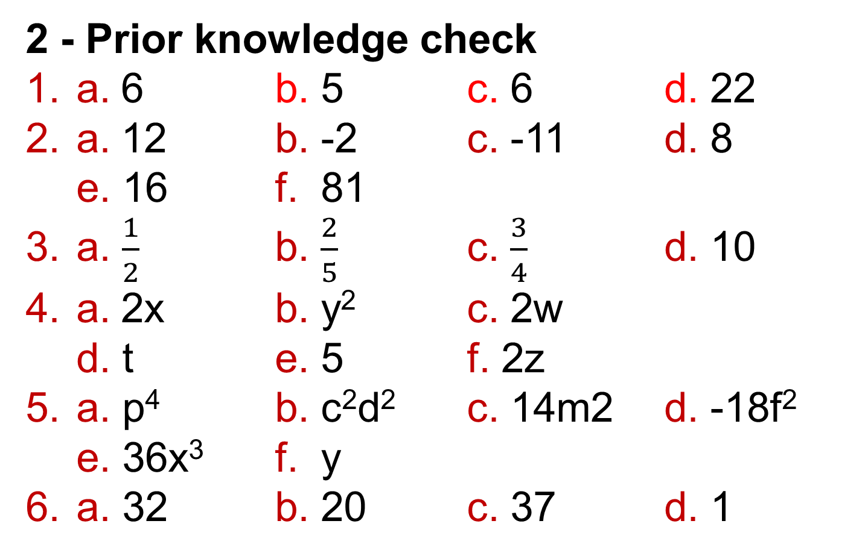
2 - Prior knowledge check
Page 627
2 - Prior knowledge check
a. 6 b. 5 c. 6 d. 22
a. 12 b. -2 c. -11 d. 8
e. 16 f. 81
a. $\frac{1}{2}$ b. $\frac{2}{5}$ c. $\frac{3}{4}$ d. 10
a. 2x b. y² c. 2w
d. t e. 5 f. 2z
a. p⁴ b. c²d² c. 14m2 d. -18f²
e. 36x³ f. y
a. 32 b. 20 c. 37 d. 1

Slide 3
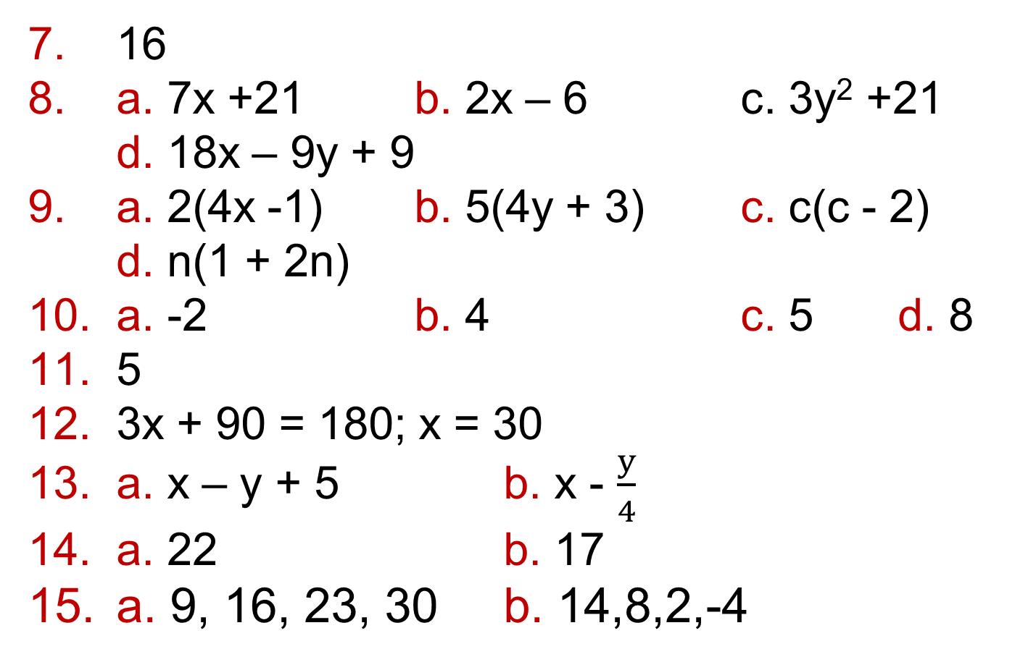
2 - Prior knowledge check
Page 627
16
a. 7x +21 b. 2x – 6 c. 3y² +21
d. 18x – 9y + 9
a. 2(4x -1) b. 5(4y + 3) c. c(c - 2)
d. n(1 + 2n)
a. -2 b. 4 c. 5 d. 8
5
3x + 90 = 180; x = 30
a. x – y + 5 b. x - $\frac{y}{4}$
a. 22 b. 17
a. 9, 16, 23, 30 b. 14,8,2,-4

Slide 4
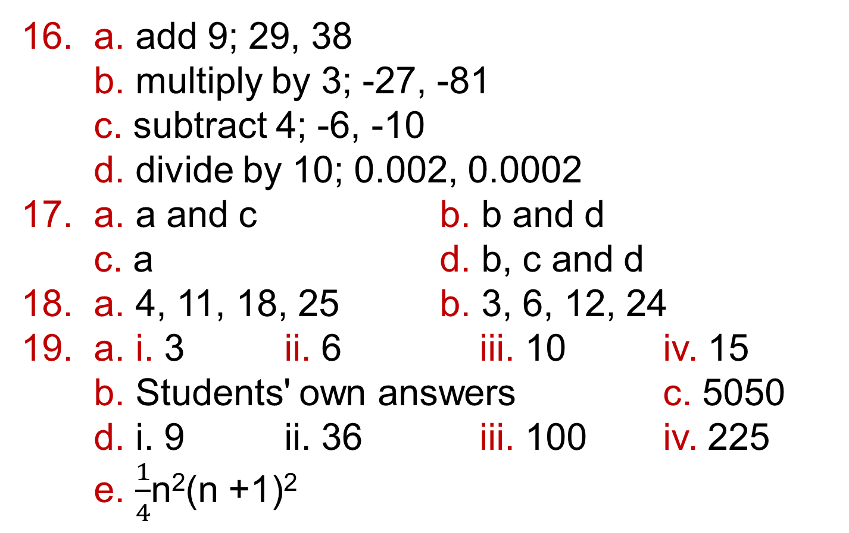
2 - Prior knowledge check
Page 627
a. add 9; 29, 38
b. multiply by 3; -27, -81
c. subtract 4; -6, -10
d. divide by 10; 0.002, 0.0002
a. a and c b. b and d
c. a d. b, c and d
a. 4, 11, 18, 25 b. 3, 6, 12, 24
a. i. 3 ii. 6 iii. 10 iv. 15
b. Students' own answers c. 5050
d. i. 9 ii. 36 iii. 100 iv. 225
e. $\frac{1}{4}$n²(n +1)²

Slide 5
2.1 – Algebraic Indices
Page 627
a. 2⁷ b. 2³ c. 2¹² d. 2⁻¹
a. 10⁵ b. 5³ c. 3³
a. x⁷ b. x⁷ c. a¹¹
d. y⁹ e. m²
a. 6a⁸ b. 8c⁶ c. 40n⁷ d. 7v⁵
e. 15s⁵t⁵ b. 30p⁶q⁶
a. x² b. x³ c. p³ d. y6
e. r f. t2

Slide 6
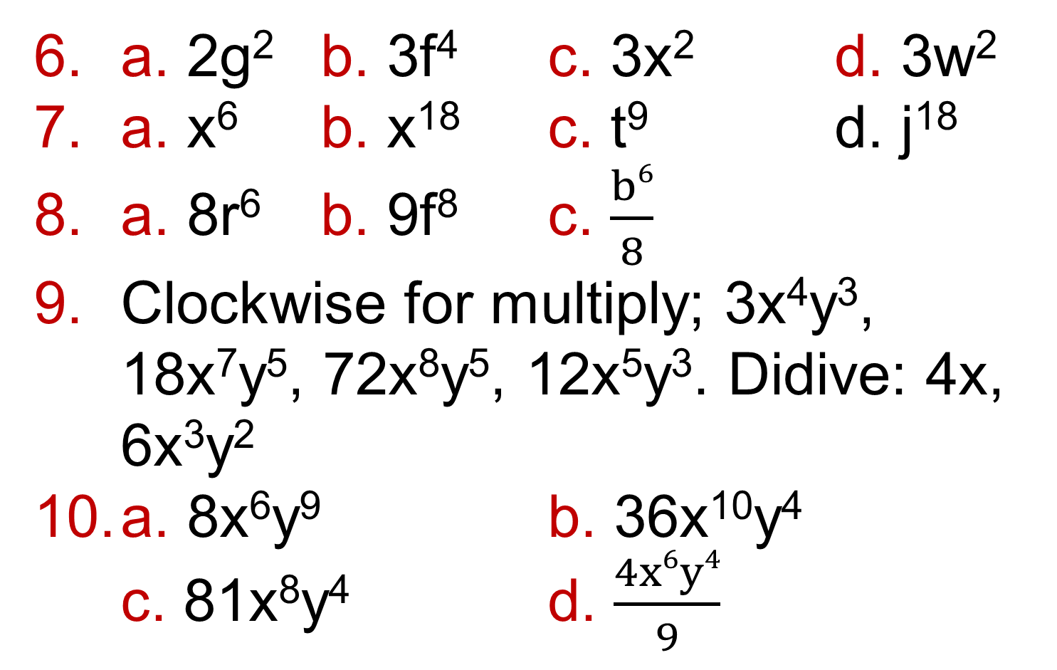
2.1 – Algebraic Indices
Page 628
a. 2g² b. 3f⁴ c. 3x² d. 3w²
a. x⁶ b. x¹⁸ c. t⁹ d. j¹⁸
a. 8r⁶ b. 9f⁸ c. $\frac{b6}{8}$
Clockwise for multiply; 3x⁴y³, 18x⁷y⁵, 72x⁸y⁵, 12x⁵y³. Didive: 4x, 6x³y²
a. 8x⁶y⁹ b. 36x¹⁰y⁴
c. 81x⁸y⁴ d. $\frac{4x6y4}{9}$

Slide 7
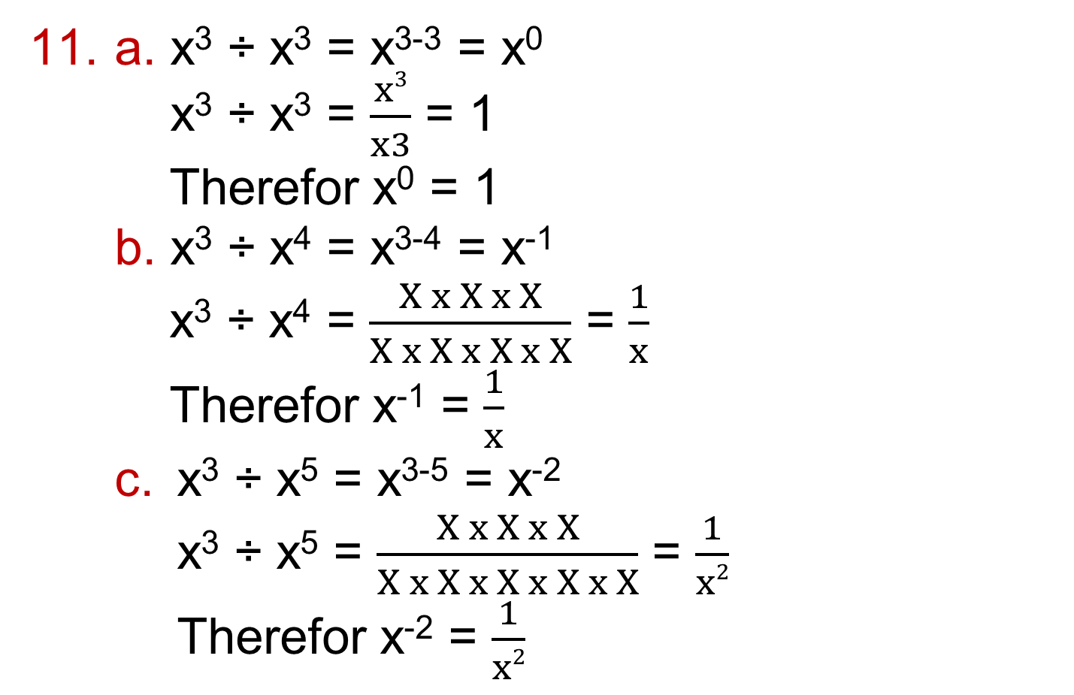
2.1 – Algebraic Indices
Page 628
a. x³ ÷ x³ = x³⁻³ = x⁰
x³ ÷ x³ = $\frac{x3}{x3}$ = 1
Therefor x⁰ = 1
b. x³ ÷ x⁴ = x³⁻⁴ = x⁻¹
x³ ÷ x⁴ = $\frac{X x X x X}{X x X x X x X}$ = $\frac{1}{x}$
Therefor x⁻¹ = $\frac{1}{x}$
  x³ ÷ x⁵ = x³⁻⁵ = x⁻²
  x³ ÷ x⁵ = $\frac{X x X x X}{X x X x X x X x X}$ = $\frac{1}{x2}$
  Therefor x⁻² = $\frac{1}{x2}$

Slide 8
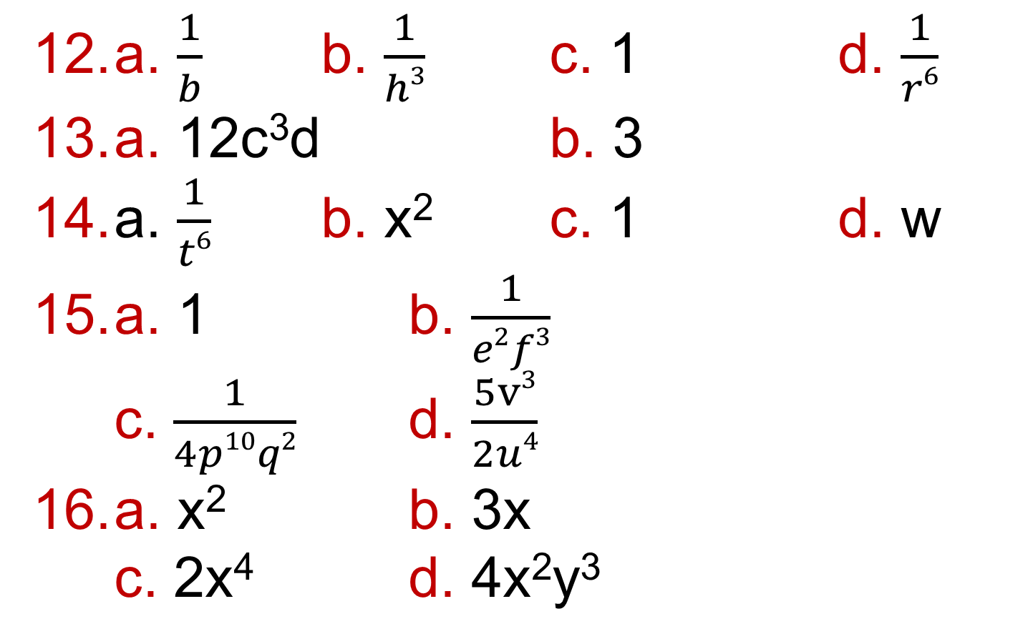
2.1 – Algebraic Indices
Page 628
a. $\frac{1}{b}$ b. $\frac{1}{h3}$ c. 1 d. $\frac{1}{r6}$
a. 12c³d b. 3
a. $\frac{1}{t6}$ b. x² c. 1 d. w
a. 1 b. $\frac{1}{e2f3}$
c. $\frac{1}{4p10q2}$ d. $\frac{5v3}{2u4}$
a. x² b. 3x
c. 2x⁴ d. 4x²y³

Slide 9
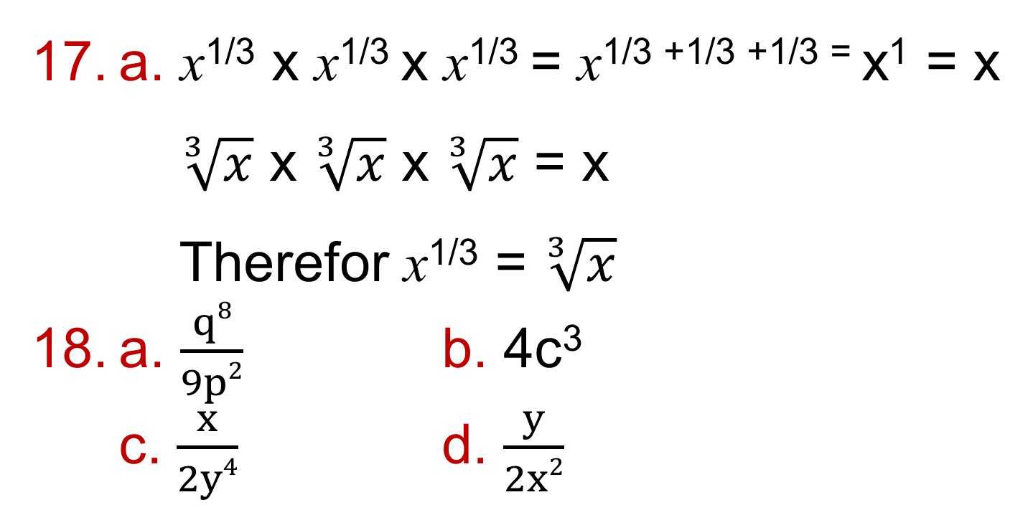
2.1 – Algebraic Indices
Page 628
a. x^{1/3} x x^{1/3} x x^{1/3} = x^{1/3 +1/3 +1/3 =} x¹ = x
$\sqrt[3]{x}$ x $\sqrt[3]{x}$ x $\sqrt[3]{x}$ = x
Therefor x^{1/3} = $\sqrt[3]{x}$
a. $\frac{q8}{9p2}$ b. 4c³
c. $\frac{x}{2y4}$ d. $\frac{y}{2x2}$

Slide 10
2.2 – Expanding and Factorising
Page 628
a. 4x + 8 b. 3q - 15 c. 14m + 7
d. -2y – 12
a. 9a + 5 b. x + 4 c. 5s
a. 2 b. 9 c. 3
a. 2(x + 5) b. 2x, 10
c. The answers to part b add up to
give the answer to part a.
a, b and d are all identities; c is an equation.

Slide 11
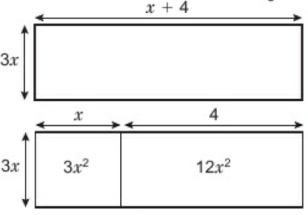
2.2 – Expanding and Factorising
Page 628
a.

Slide 12
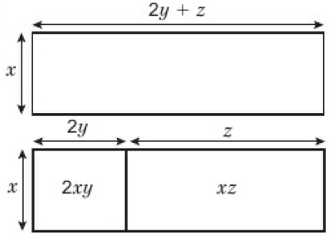
2.2 – Expanding and Factorising
Page 628
b.

Slide 13
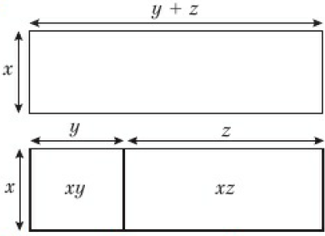
2.2 – Expanding and Factorising
Page 628
c.

Slide 14
2.2 – Expanding and Factorising
Page 628
a. i. 5xy + 20x ii. 3xy + 6y
b. 8xy + 20x + 6y
a. 8e + 18 b. 8y +14 c. 4x + 27
d. 9m + 27 e. 5a + 8b f. 13x + 8y
a. x² – 2x b. 11y - 12 c. 10t – 6
d. 2p² + pq + q² e. w + 3w²
f. 5e² + 3ef + 2f²
a. 2x b. x c. 4y d. 5xy

Slide 15
2.2 – Expanding and Factorising
Page 628
a. 2(x + 6) b. 2x(2 + 3y)
c. b(3a - 5) d. 7x(y + z)
e. ab(1 - c) f. t²(t + 2)
g. 3pq(2p - 3) h. 3xz(x + 4)
i. 5jk(4k – 3j) j. 2pq(6r - 5s)
a. 4(s + 2t)
b. = 4(s + 2t)[(s + 2t) - 2]
= 4(s + 2t)(s + 2t -2)

Slide 16
2.2 – Expanding and Factorising
Page 628
a. 7(p + 1)(2p + 5) b. 5(c + 1)(c - 1)
c. 4(y + 4)(3y + 10) d. (a + b)(a + b - 2)
e. 5(f + 5)(1 + 2f) f. 5(a + b)(a + b - 2)
One of the numbers is even so can be written as 2m.
One of the other numbers is a multiple of three so can be written as 3n.
If the other number is p their product is
2m x 3n x p = 6mnp so is divisible by 6.
a. 8x² - 20xy b. 2cp(2 - 3p) c. 3m²n³

Slide 17
2.3 – Equations
Page 628
a. x = 7 b. x = 1 c. x = 2
a. 6 b. 24 c. 12
3³ - 2 x 3 = 27 - 6 = 21
a. 8x + 6 b. 21x – 4 c. -8x + 17
a. 3x + 1 – 3x = 5x - 9 – 3x
1 = 2x – 9
b. x = 5
a. 5 b. 4 c. 10 d. -2
a. i. 12x – 16 ii. 7x – 21
b. -1

Slide 18
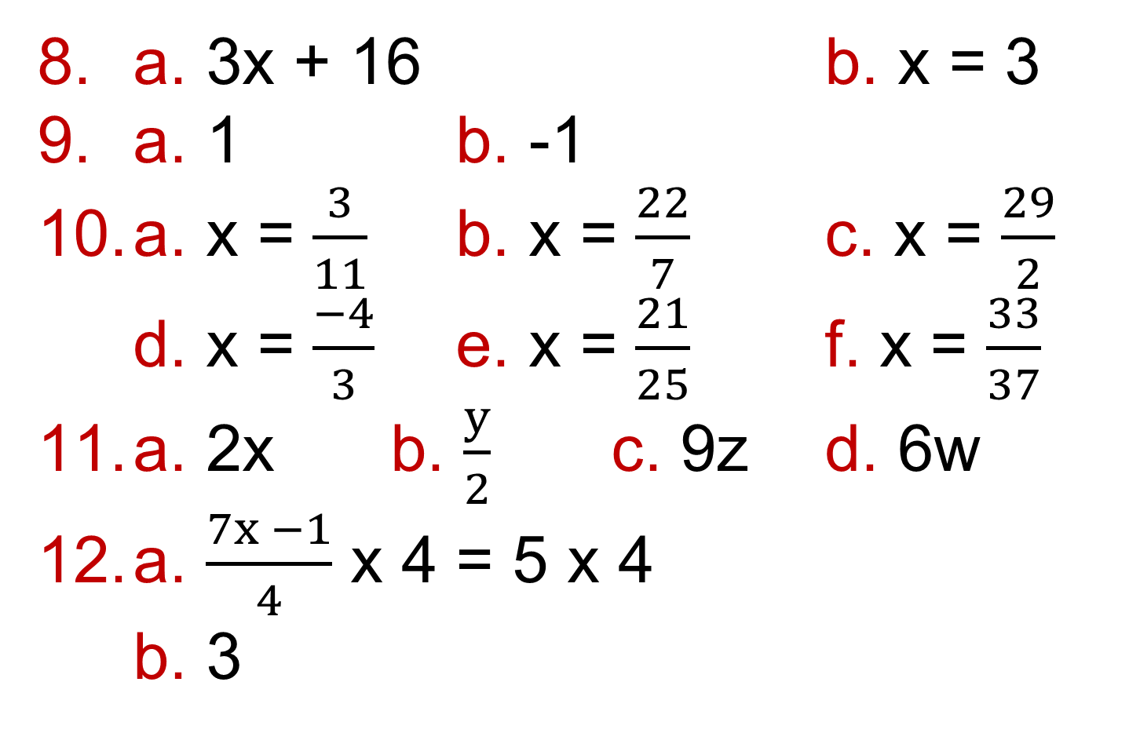
2.3 – Equations
Page 628
a. 3x + 16 b. x = 3
a. 1 b. -1
a. x = $\frac{3}{11}$ b. x = $\frac{22}{7}$ c. x = $\frac{29}{2}$
d. x = $\frac{−4}{3}$ e. x = $\frac{21}{25}$ f. x = $\frac{33}{37}$
a. 2x b. $\frac{y}{2}$ c. 9z d. 6w
a. $\frac{7x −1}{4}$ x 4 = 5 x 4
b. 3

Slide 19
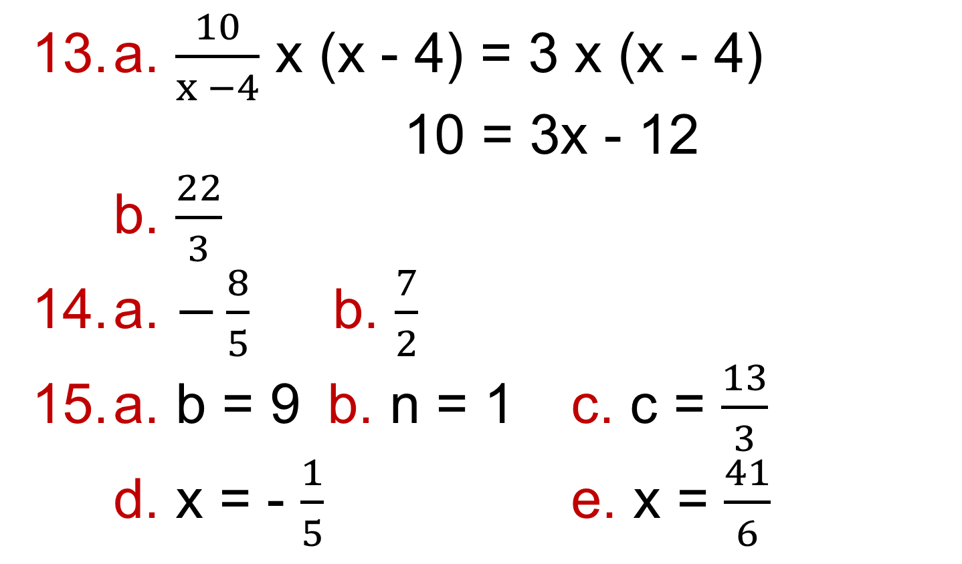
2.3 – Equations
Page 628
a. $\frac{10}{x −4}$ x (x - 4) = 3 x (x - 4)
10 = 3x - 12
b. $\frac{22}{3}$
a. $−\frac{8}{5}$ b. $\frac{7}{2}$
a. b = 9 b. n = 1 c. c = $\frac{13}{3}$
d. x = - $\frac{1}{5}$ e. x = $\frac{41}{6}$

Slide 20
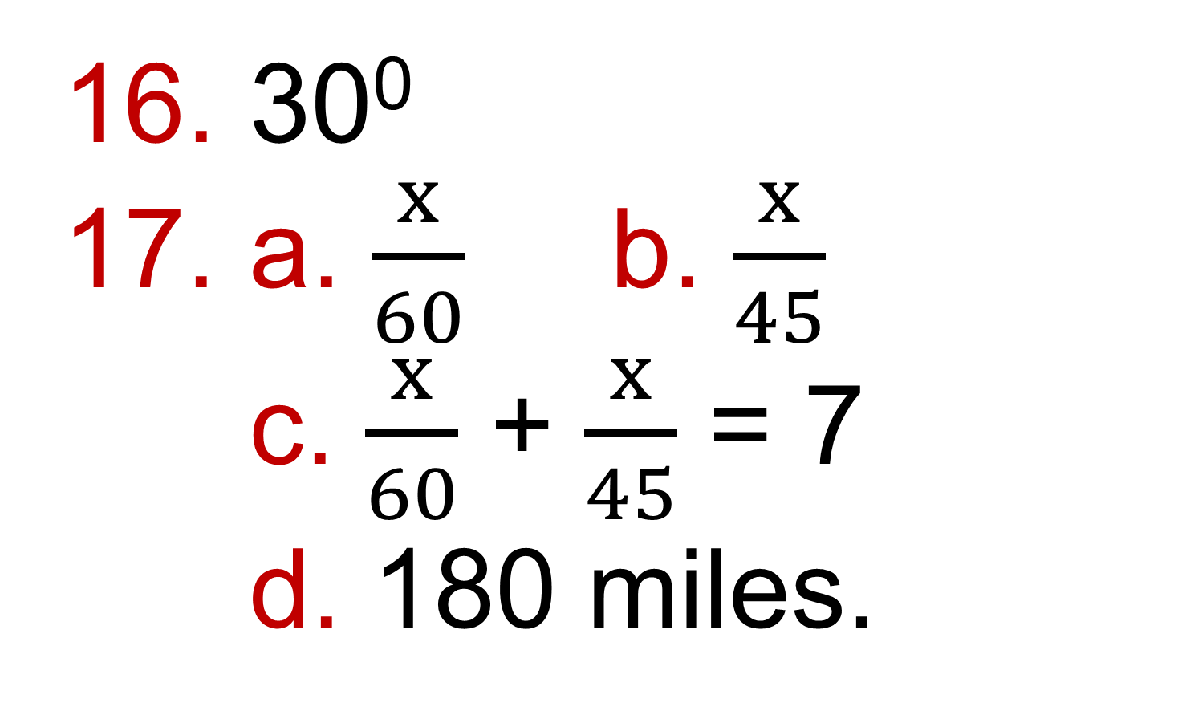
2.3 – Equations
Page 628
30⁰
a. $\frac{x}{60}$ b. $\frac{x}{45}$
c. $\frac{x}{60}$ + $\frac{x}{45}$ = 7
d. 180 miles.

Slide 21
2.4 – Formulae
Page 628
a. 4 b. 13 c. 32 d. 17
a. 7.5 x 10⁷ b. 300,000,000
1.22
a. Formula b. Equation c. Expression d. Identity e. Expression f. Formula
g. Expression h. Equation
i. Identity j. Equation
a. 2000 b. -2
a. 350 b. 8
a. 130 minutes b. T = 30 + 40m

Slide 22
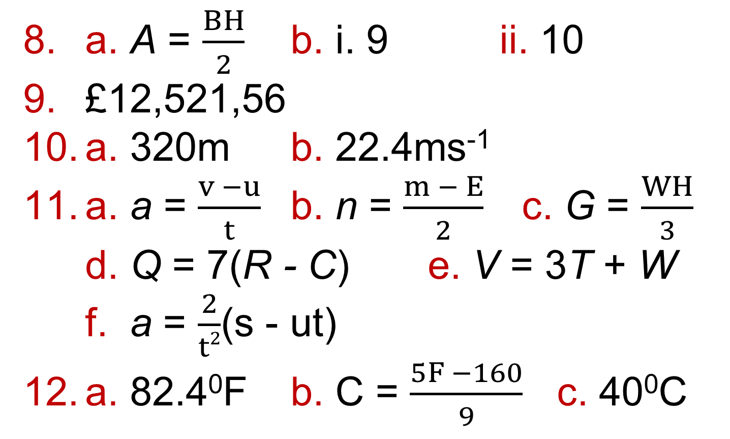
2.4 – Formulae
Page 629
a. A = $\frac{BH}{2}$ b. i. 9 ii. 10
£12,521,56
a. 320m b. 22.4ms⁻¹
a. a = $\frac{v −u}{t}$ b. n = $\frac{m − E}{2}$ c. G = $\frac{WH}{3}$
d. Q = 7(R - C) e. V = 3T + W
f. a = $\frac{2}{t2}$(s - ut)
a. 82.4⁰F b. C = $\frac{5F −160}{9}$ c. 40⁰C

Slide 23
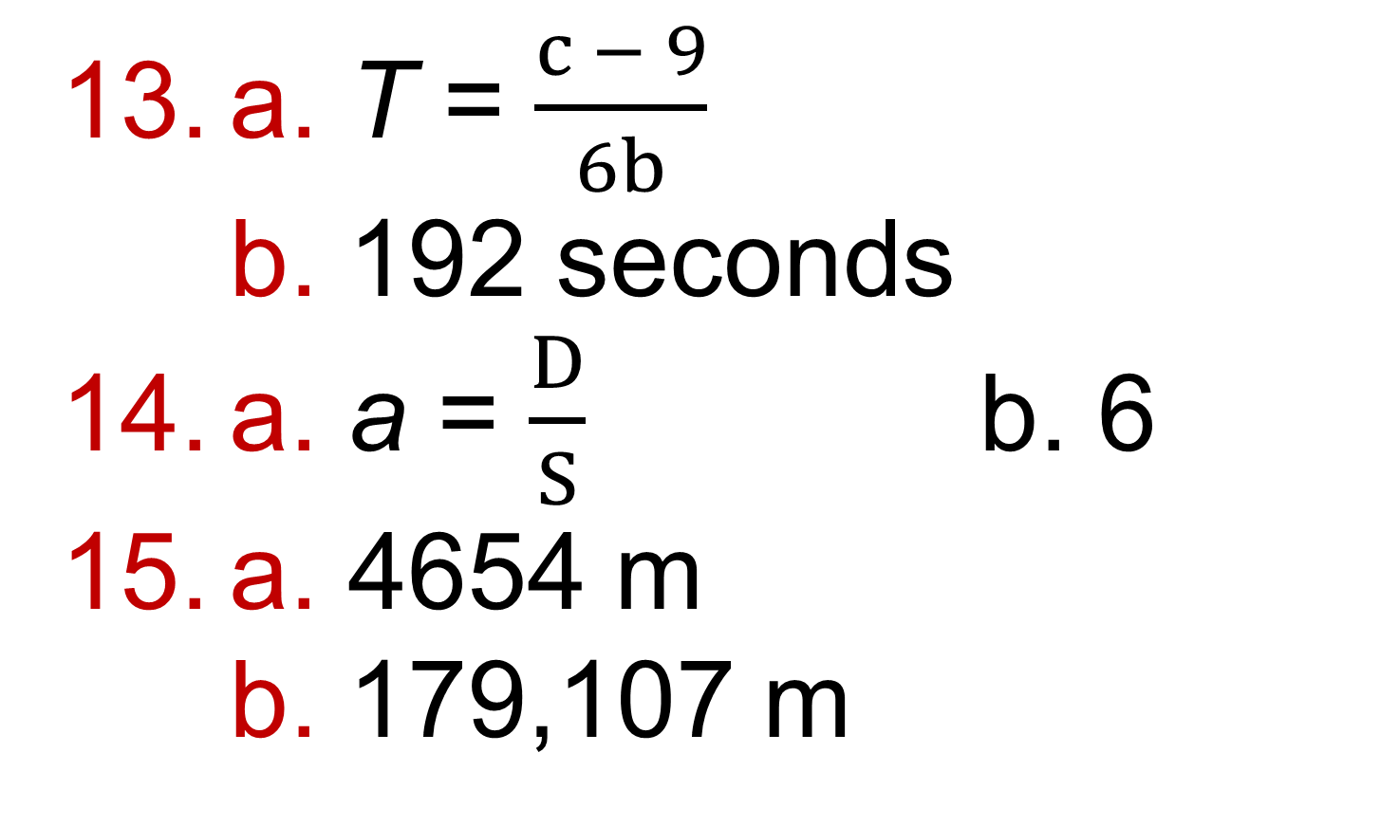
2.4 – Formulae
Page 629
a. T = $\frac{c − 9}{6b}$
b. 192 seconds
a. a = $\frac{D}{S}$ b. 6
a. 4654 m
b. 179,107 m

Slide 24
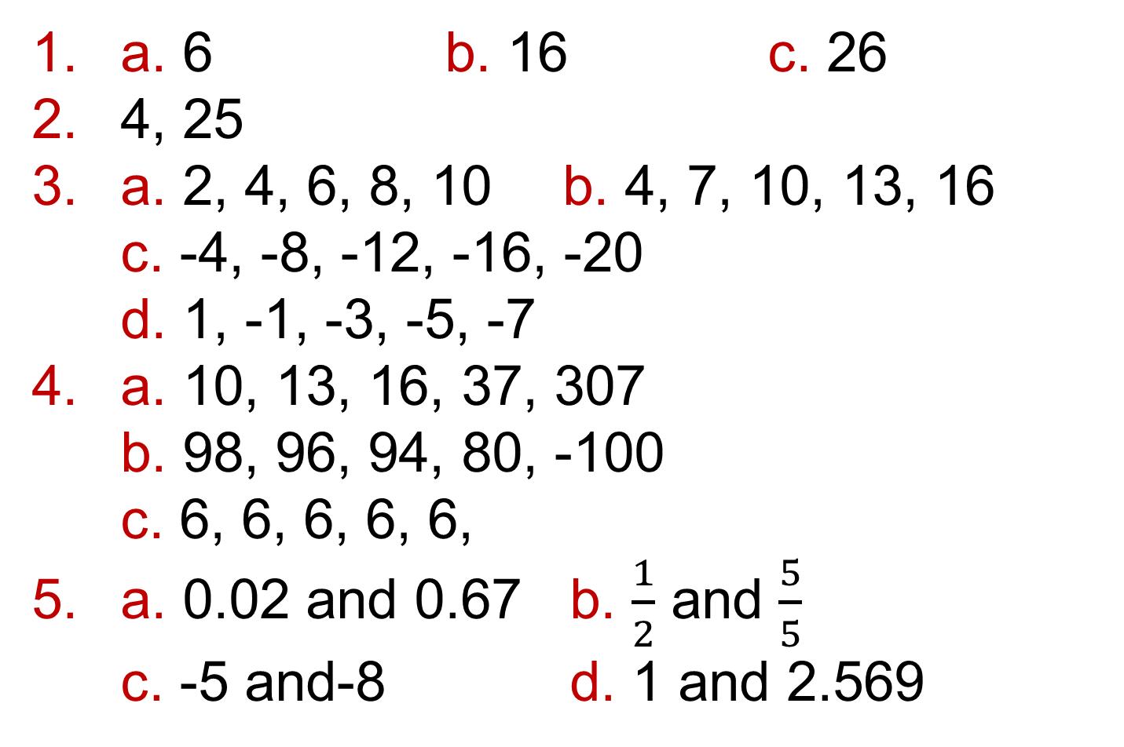
2.5 – Linear Sequences
Page 629
a. 6 b. 16 c. 26
4, 25
a. 2, 4, 6, 8, 10 b. 4, 7, 10, 13, 16
c. -4, -8, -12, -16, -20
d. 1, -1, -3, -5, -7
a. 10, 13, 16, 37, 307
b. 98, 96, 94, 80, -100
c. 6, 6, 6, 6, 6,
a. 0.02 and 0.67 b. $\frac{1}{2}$ and $\frac{5}{5}$
c. -5 and-8 d. 1 and 2.569

Slide 25
2.5 – Linear Sequences
Page 629
a. 3, 2, 3, -4, -2
b. In front of n
c. i. 5 ii. -3
d. i. 3. 8, 13 ii. 1, -2, -5
a. 2n + 1 b. 4n + 10
c. 10n – 8 d. -3n + 16

Slide 26
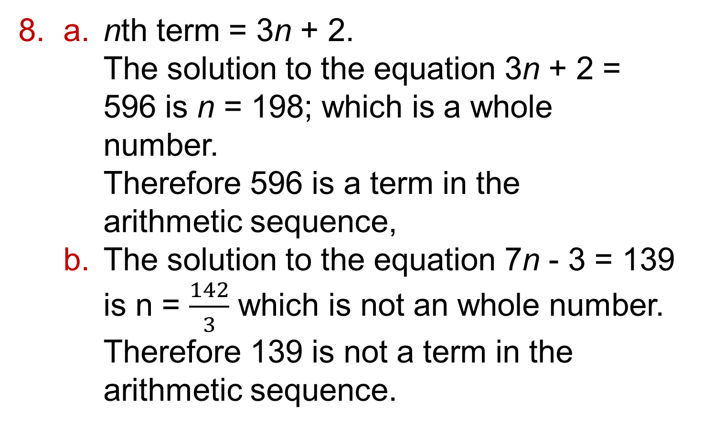
2.5 – Linear Sequences
Page 629
a. nth term = 3n + 2.
The solution to the equation 3n + 2 = 596 is n = 198; which is a whole number.
Therefore 596 is a term in the arithmetic sequence,
  The solution to the equation 7n - 3 = 139 is n = $\frac{142}{3}$ which is not an whole number.
  Therefore 139 is not a term in the arithmetic sequence.

Slide 27
2.5 – Linear Sequences
Page 629
a. 6n – 3
  No Ben is not right. The solution to the equation 6n - 3 = 150 is n = 25.5 which is not a whole number. Therefore 150 is not a term in the arithmetic sequence.
a. 125.375
  From part a it is the 126th term; this is
  8 x 126 - 3 = 1005
a. 4007 b. 49
a. i. 99.6kg ii. 99.2kg iii. 98.8kg
b. 28 weeks

Slide 28
2.5 – Linear Sequences
Page 629
28 weeks
a. 10, 17, 24, 31 b. 7 c. 3
a. i. 9, 21, 33, 45, 57
ii. 41, 81, 121, 161, 201
b.
    The differences are scaled by 4 which is the multiplier in the function machine.
    a. 4 b. 8 c. 2 d. q = 4
    p = 7, q = 6
Sequence | Input difference | Output difference
i. | 3 | 12
ii. | 10 | 40

Slide 29
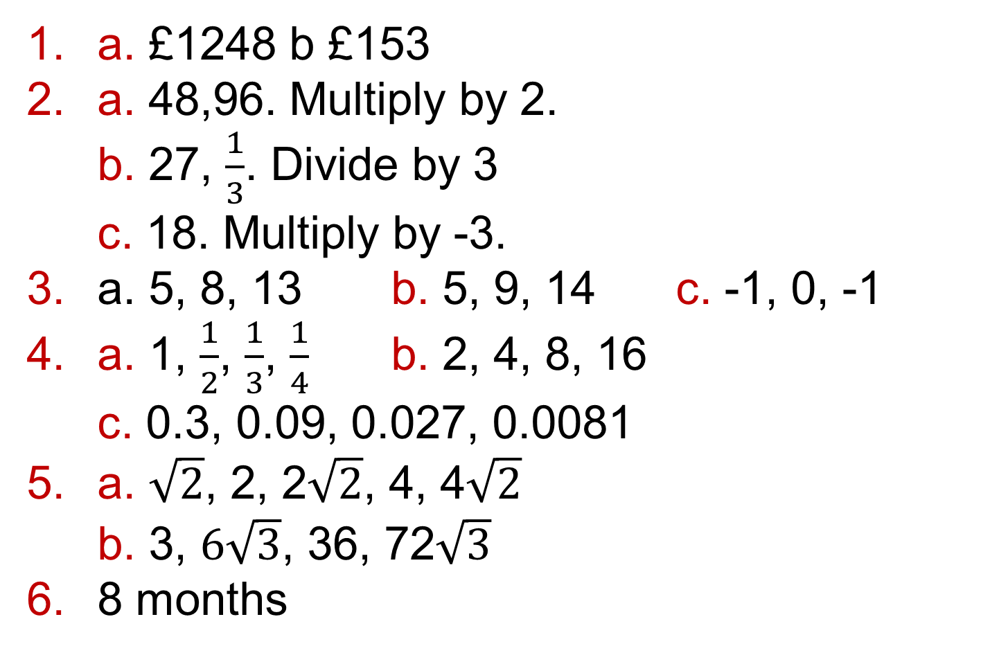
2.6 – Non-Linear Sequences
Page 629
a. £1248 b £153
a. 48,96. Multiply by 2.
b. 27, $\frac{1}{3}$. Divide by 3
c. 18. Multiply by -3.
a. 5, 8, 13 b. 5, 9, 14 c. -1, 0, -1
a. 1, $\frac{1}{2}$, $\frac{1}{3}$, $\frac{1}{4}$ b. 2, 4, 8, 16
c. 0.3, 0.09, 0.027, 0.0081
a. $\sqrt{2}$, 2, 2$\sqrt{2}$, 4, 4$\sqrt{2}$
b. 3, $6\sqrt{3}$, 36, 72$\sqrt{3}$
8 months

Slide 30
2.6 – Non-Linear Sequences
Page 629
a. £8,400
b. i. £8,820 ii. £9,261
Option 1 gives £10,400 and Option 2 gives £14,486.54.
Option 2 gives more money.
a. 1, 4, 9, 16, 25, 36
b. i. n² + 1 ii. n² - 1
iii. (n + 1)²

Slide 31
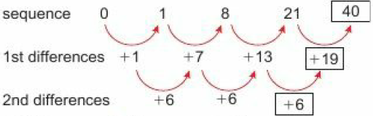
2.6 – Non-Linear Sequences
Page 629
a. 126 b. 46 c. 10

Slide 32
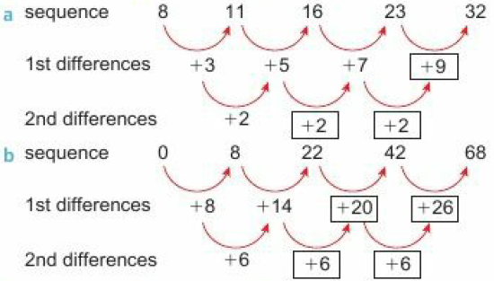
2.6 – Non-Linear Sequences
Page 629

Slide 33
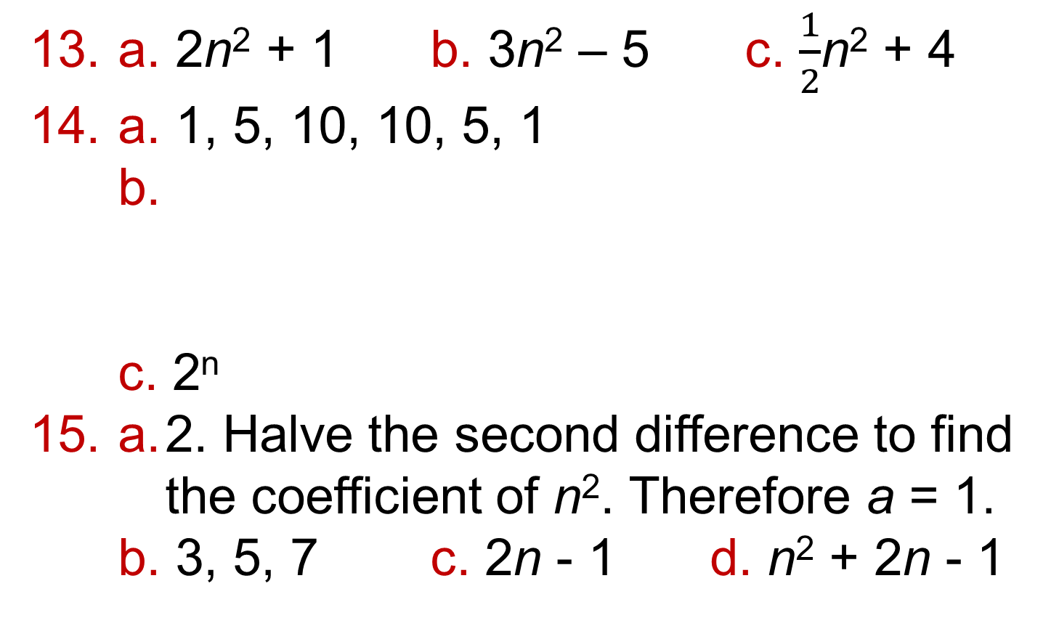
2.6 – Non-Linear Sequences
Page 629
a. 2n² + 1 b. 3n² – 5 c. $\frac{1}{2}$n² + 4
a. 1, 5, 10, 10, 5, 1
b.
c. 2^{n}
a. 2. Halve the second difference to find the coefficient of n². Therefore a = 1.
b. 3, 5, 7 c. 2n - 1 d. n² + 2n - 1
Row, n | 0 | 1 | 2 | 3 | 4 | 5
Sum | 1 | 2 | 4 | 8 | 16 | 32

Slide 34
2.6 – Non-Linear Sequences
Page 629
a. n² + 3n or n(n + 3)
b. (n-1)²
c. 2n² + n + 2
d. 3n² - n + 1
u₅ x u₈ = 10⁵ x 10⁸ = 10⁵⁺⁸ = 10¹³ = u₁₃
a. 2, 4, 8, 16
b. Multiply by 2
c. u_{m} x u_{n} = 2^{m} x 2^{n} = 2^{m+n} = u_{m+n}

Slide 35
2.7 – More Expanding and Factorising
Page 629
a. 2, 3 b. -4, -1
a. 4x² b. 25y²
a. (x + 2)(x + 1)
b. x² + x + 2x + 2; x² + 3x + 2
a. x² + 16x + 60 b. x² + 3x – 18
c. x² + 6x - 40 d. x² - 7x + 12
a. (x + 2)(x + 3) = x² + 5x + 6
b. (x - 3)(x + 8) = x² + 5x - 24
i. x² + 4x + 4 b. x² - 6x + 9
c. x² + 10x + 25 d. x² - 8x + 16

Slide 36
2.7 – More Expanding and Factorising
Page 630
a. (51 + 49)(51 - 49) = 2 x 100 = 200
b. i. 400 ii. 0.12
a. x² – 16 b. x² - 4
a. (x - 5)(x + 5) b. (y - 7)(y + 7)
c. (t - 9)(t + 9)
a. (x +1)(x + 7) b. (x + 3)(x + 4)
c. (x + 3)(x + 5) d. (x + 3)(x - 1)
e. (x - 3)(x + 1) f. (x - 2)(x - 4)
g. (x - 7)(x + 1) h. (x - 3)(x - 4)
i. (x - 2)² j. (x - 12)(x – 2)
k. (x - 8)(x + 2) I. (x + 1)²

Slide 37
2.7 – More Expanding and Factorising
Page 630
a. (x + 5)(x + 2) = x2 + 7x + 10
b. 7x + 10 c. x = 3
x = 1.5
a. 4x² - 9 = (2x)² – 3² = (2x - 3)(2x + 3)
b. 16y² - 1 = (4y)² = (4y - 1)(4y + 1)
a. (3m - 5)(3m + 5)
b. (5c - 9)(5c + 9)
c. (x – 7y)(x + 7y)
a. (x + 5)(x + 6)
b. 9u² - 24uv + 16v²

Slide 38
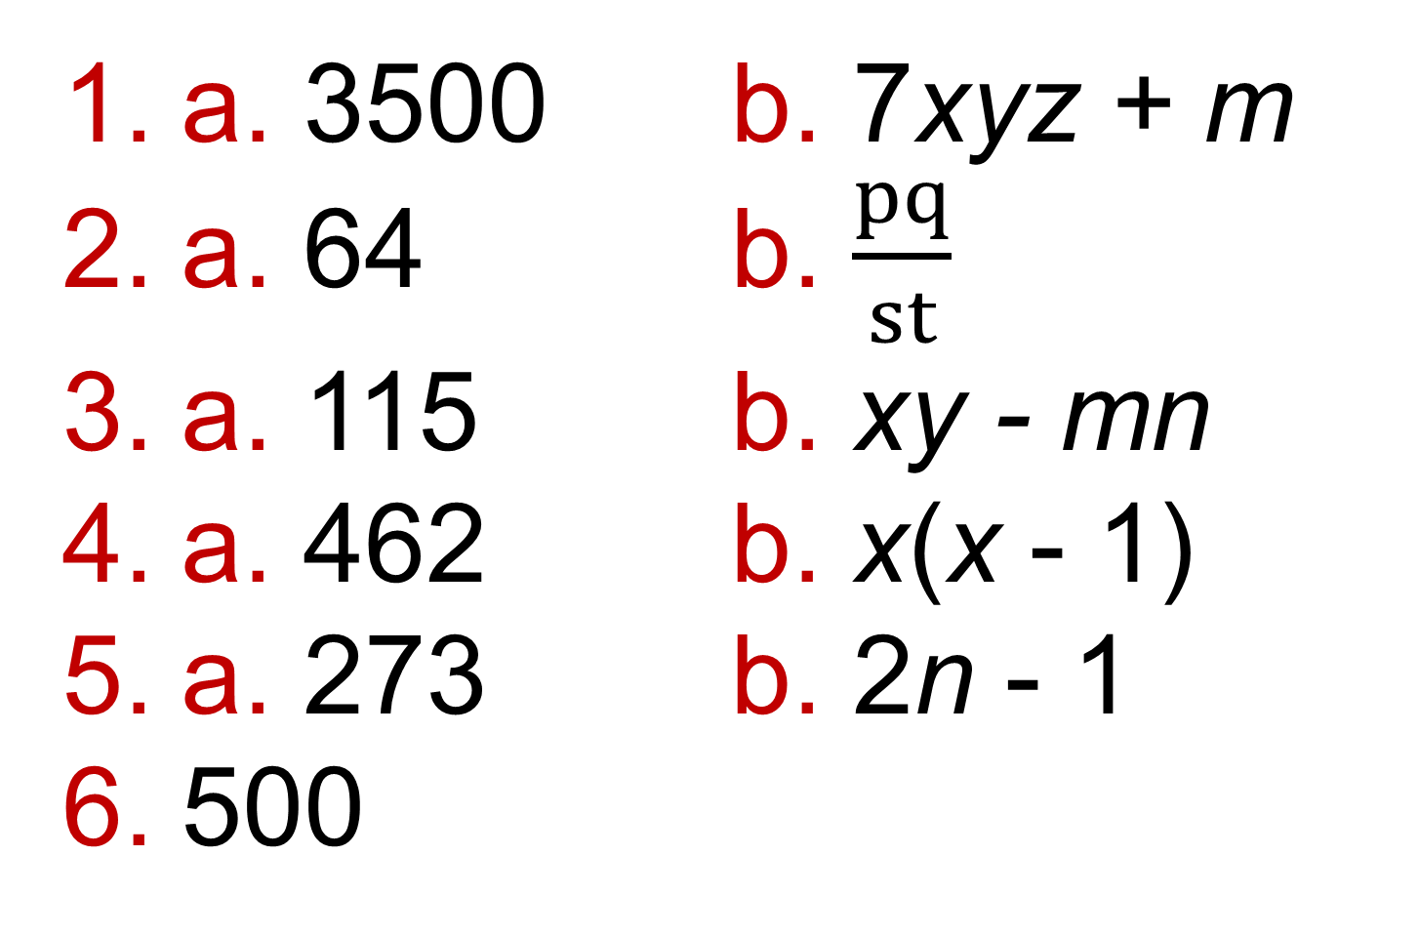
2 – Problem Solving
Page 630
a. 3500 b. 7xyz + m
a. 64 b. $\frac{pq}{st}$
a. 115 b. xy - mn
a. 462 b. x(x - 1)
a. 273 b. 2n - 1
500

Slide 39
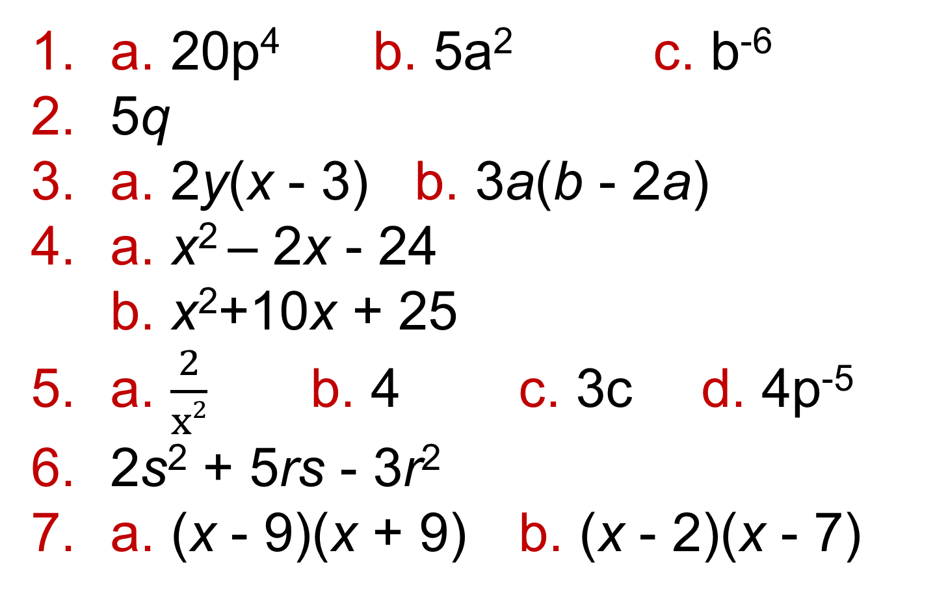
2 – Check Up
Page 630
a. 20p⁴ b. 5a² c. b⁻⁶
5q
a. 2y(x - 3) b. 3a(b - 2a)
a. x² – 2x - 24
b. x²+10x + 25
a. $\frac{2}{x2}$ b. 4 c. 3c d. 4p⁻⁵
2s² + 5rs - 3r²
a. (x - 9)(x + 9) b. (x - 2)(x - 7)

Slide 40
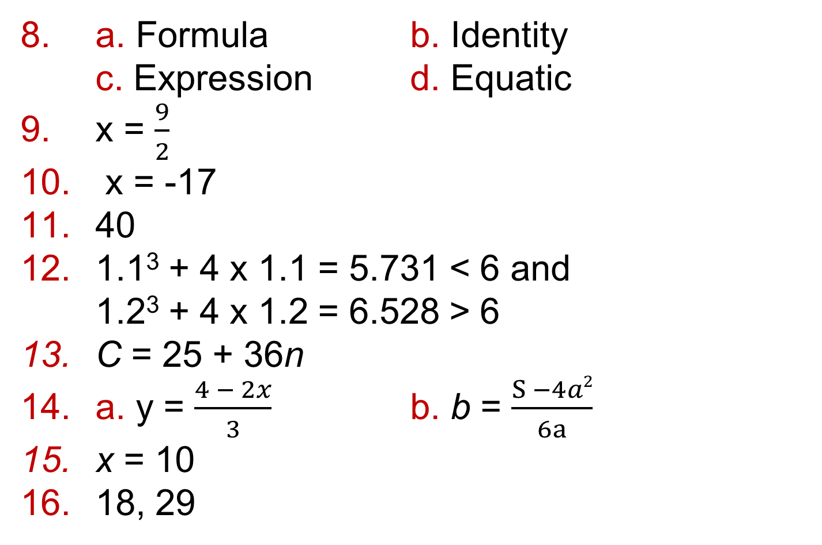
2 – Check Up
Page 630
a. Formula b. Identity
c. Expression d. Equatic
x = $\frac{9}{2}$
x = -17
40
1.1³ + 4 x 1.1 = 5.731 < 6 and
1.2³ + 4 x 1.2 = 6.528 > 6
C = 25 + 36n
a. y = $\frac{4 − 2x}{3}$ b. b = $\frac{S −4a2}{6a}$
x = 10
18, 29

Slide 41
2 – Check Up
Page 630
a. 9n – 7
  The equation 9n - 7 = 167 has solution which is not a whole number.
  Therefore 167 is not a term in the sequence.
  173
3n² + 7
a. Clockwise from top left:
x² + x - 6, 3x² – 7x + 2, 6x² + 10x - 4,
2x² + 10x +12.
  12x² + 14x + 4. Any order would give the same result, multiplication is not commutative,
  2(2x +1)(3x + 2)

Slide 42
2 – Strengthen
Page 630
Simplifying, expanding and factorising
a. t⁵ b. t⁷ c. t⁴ d. t²
e. t⁻⁷ f. t²
a. 18p⁵ b. 72z⁵ c. 14b⁸ d. 8r³
e. 6x² f. 10s⁻⁶
a. t⁴ b. t³ c. t⁰ = 1
a. 5p⁴ b. 3a⁵ c. 3y⁻³ d. 2p

Slide 43
2 – Strengthen
Page 630
a. (x²)² = x² x x² = x⁴
b. (x²)³ = x² x x² x x² = x⁶
c. (x²)⁴ = x² x x² x x² x x² = x⁸
d. When you find the power of a power you
multiply the powers together.
a. a² b. r⁻² c. 8g
a. 6x + 3y b. 6x – 8y c. 12x – 5y
a. 11c + d
b. 12m + 10n
a. ab(3b – 2) b. 2x(4y + 3)
c. 3st(t - 2) d. 7b(2ab + 3)

Slide 44
2 – Strengthen
Page 630
a.
b. (x + 4)(x + 5) = x² + 5x + 4x + 20
= x² + 9x + 20
a. x² – 12x + 36 b. x² - 16
x | x | +5
x | x² | 5x
+4 | 4x | +20
x | x | -6
x | x² | -6x
-6 | -6x | +36
x | x | +4
x | x² | +4x
-4 | -4x | -16

Slide 45
2 – Strengthen
Page 630
a. 3x² + 26x + 16 b. 10x² + 11x + 3
c. 3x² + 5x - 28
x | 3x | +2
x | 3x² | +2x
+8 | +24x | +16
x | 2x | +1
5x | 10x² | +5x
+3 | +6x | +3
x | 3x | -7
X | 3x² | -7x
+4 | +12x | -28

Slide 46
2 – Strengthen
Page 630
(x - 3)² = x² – 6 + 9
(x + 1)(x + 5) = x² + 6x + 5
(x - 3)(x + 3) = x² - 9
(x + 2)(x - 3) = x² - x - 6
(x + 3)(x + 2) = x² + 5x + 6
a. 3 and 4, 2 and 6
b. 2 and 6
c. (x + 2)(x + 6)

Slide 47
2 – Strengthen
Page 630
a. (x + 12)(x + 1) b. (x + 3)(x + 4)
a. 2 and -5, 1 and -10, -1 and 10
b. i. (x -10)(x + 1) ii. (x +10)(x - 1)
iii. (x + 5)(x -2) iv. (x - 5)(x + 2)
a. -24 and -1, -4 and -6, -2 and
-12
b. i. (x - 1)(x - 24)
ii. (x - 2)(x - 12)
iii. (x - 4)(x - 6) iv. (x - 3)(x - 8)

Slide 48
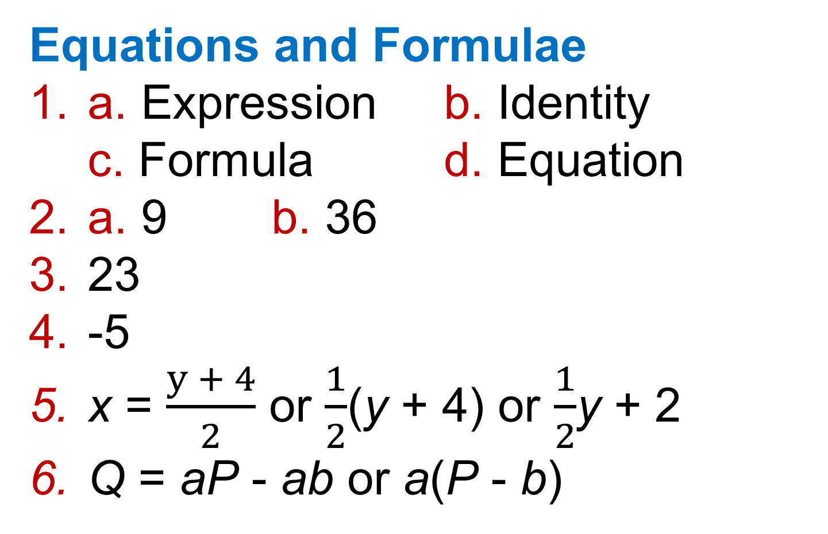
2 – Strengthen
Page 630
Equations and Formulae
a. Expression b. Identity
c. Formula d. Equation
a. 9 b. 36
23
-5
x = $\frac{y + 4}{2}$ or $\frac{1}{2}$(y + 4) or $\frac{1}{2}$y + 2
Q = aP - ab or a(P - b)

Slide 49
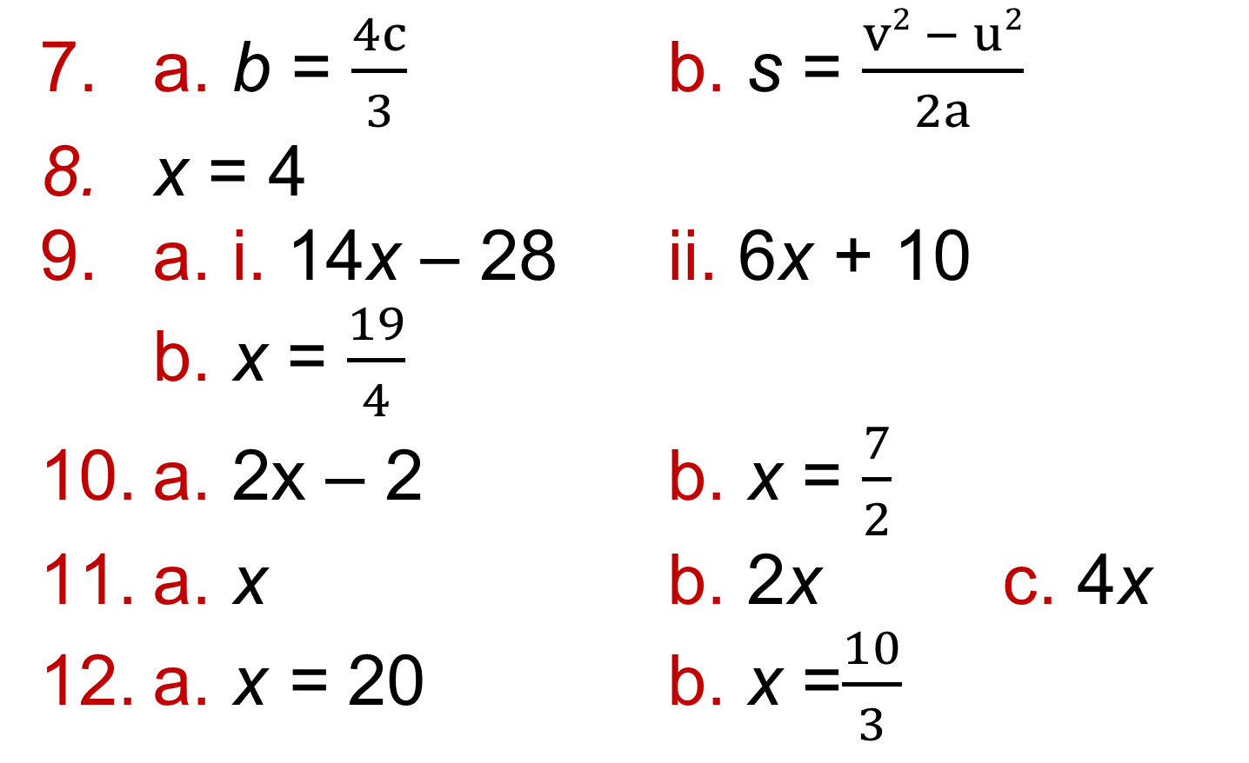
2 – Strengthen
Page 631
a. b = $\frac{4c}{3}$ b. s = $\frac{v2 − u2}{2a}$
x = 4
a. i. 14x – 28 ii. 6x + 10
b. x = $\frac{19}{4}$
a. 2x – 2 b. x = $\frac{7}{2}$
a. x b. 2x c. 4x
a. x = 20 b. x =$\frac{10}{3}$

Slide 50
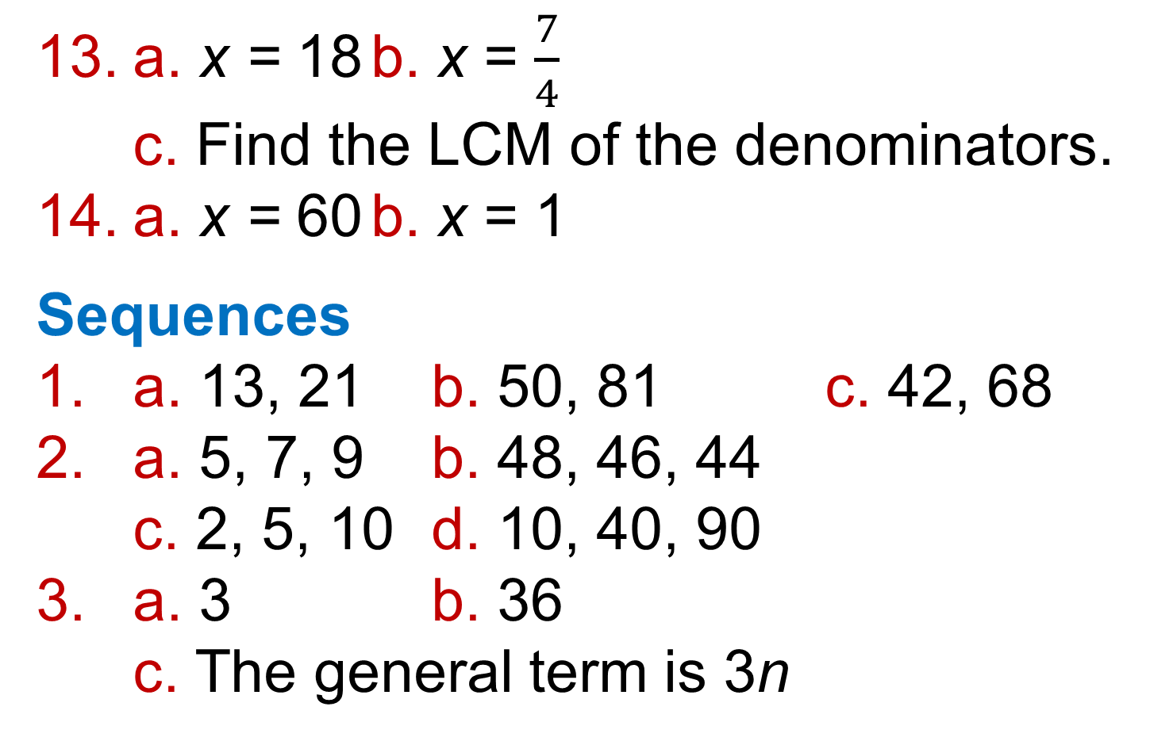
2 – Strengthen
Page 631
a. x = 18 b. x = $\frac{7}{4}$
c. Find the LCM of the denominators.
a. x = 60 b. x = 1
Sequences
a. 13, 21 b. 50, 81 c. 42, 68
a. 5, 7, 9 b. 48, 46, 44
c. 2, 5, 10 d. 10, 40, 90
a. 3 b. 36
c. The general term is 3n

Slide 51
2 – Strengthen
Page 631
a. 10n b. 7n c. 12n
a. 6
b. The general term is n + 12
a. n + 2 b. n + 12 c. n – 4
a. 4n b. 3 c. 4n + 3
a. i. 20, 36 ii. 9, 11 iii. 16, 19
iv. 5, 0
b. i. 6n ii. 2n - 1 iii. -5n + 30

Slide 52
2 – Strengthen
Page 631
a. 14, 18, 22, 26, 30
b. The numbers in the sequence
are even but 351 is odd.
c. 23rd
a. 20th b. 112 c. 152
a. 53, 14, 18, 4, 4
b. 2n² + 3
a. 4n² + 5
b. n² - 10

Slide 53
2 – Extend
Page 631
a. i. 6, 7, 8 ii. 20,10, 5
iii. 3, -1, -5 iv. -3, 9, -27
b. i and iii are arithmetic; ii and iv
are geometric
a. 0.473 b. 11.5 c. 13 d. 15.7
a. In-store; 12800,10240;
Online; 3240, 4860
b. 2017
£838.76
13

Slide 54
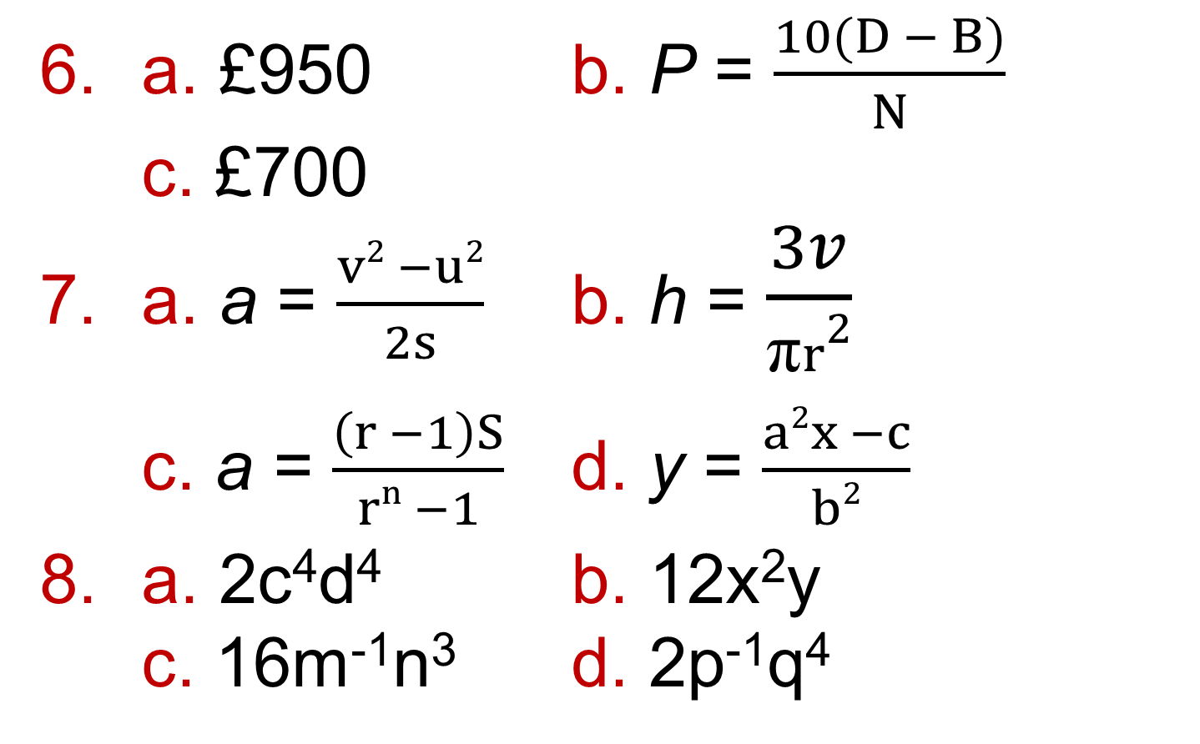
2 – Extend
Page 631
a. £950 b. P = $\frac{10(D − B)}{N}$
c. £700
a. a = $\frac{v2 −u2}{2s}$ b. h = $\frac{3v}{\text{π}r2}$
c. a = $\frac{\left(r −1\right)S}{rn −1}$ d. y = $\frac{a2x −c}{b2}$
a. 2c⁴d⁴ b. 12x²y
c. 16m⁻¹n³ d. 2p⁻¹q⁴

Slide 55
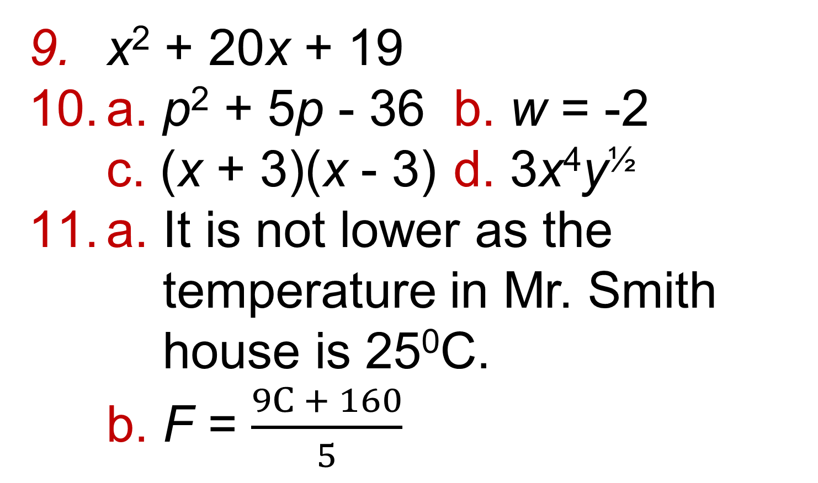
2 – Extend
Page 631
x² + 20x + 19
a. p² + 5p - 36 b. w = -2
c. (x + 3)(x - 3) d. 3x⁴y^{½}
a. It is not lower as the
temperature in Mr. Smith
house is 25⁰C.
b. F = $\frac{9C + 160}{5}$

Slide 56
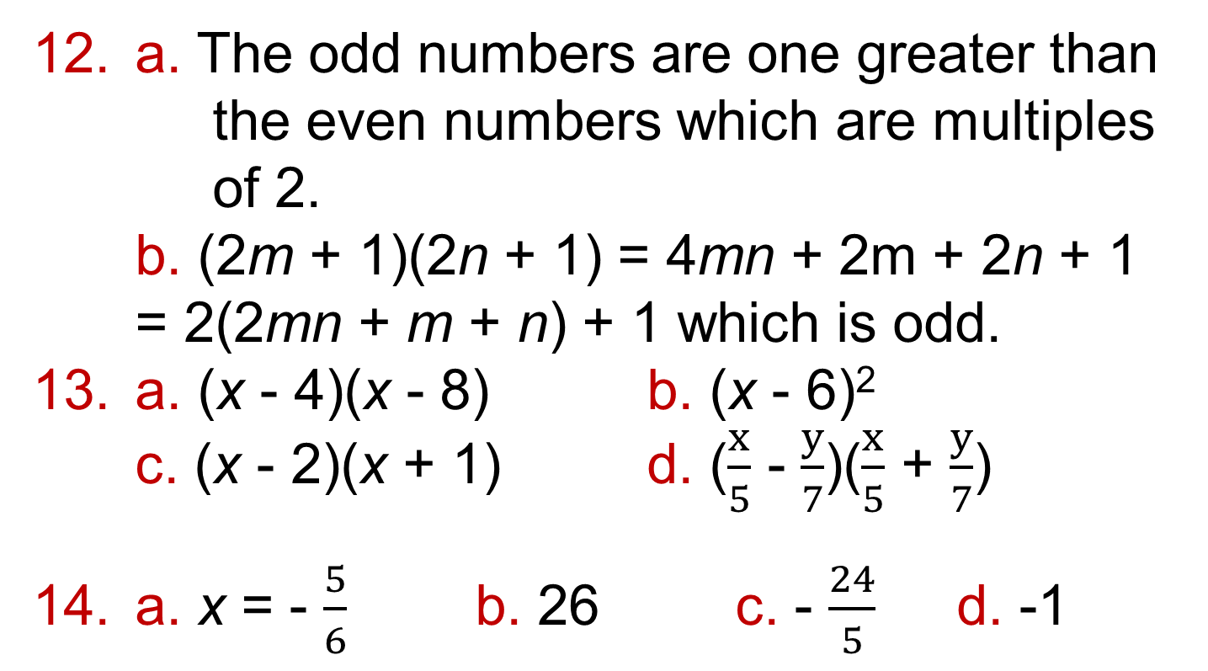
2 – Extend
Page 631
a. The odd numbers are one greater than
the even numbers which are multiples
of 2.
b. (2m + 1)(2n + 1) = 4mn + 2m + 2n + 1
= 2(2mn + m + n) + 1 which is odd.
a. (x - 4)(x - 8) b. (x - 6)²
c. (x - 2)(x + 1) d. ($\frac{x}{5}$ - $\frac{y}{7}$)($\frac{x}{5}$ + $\frac{y}{7}$)
a. x = - $\frac{5}{6}$ b. 26 c. - $\frac{24}{5}$ d. -1

Slide 57
2 – Extend
Page 631
If the consecutive numbers are n and n + 1 then the difference between their squares is
(n + 1)² - n² = n² + 2n + 1 - n² = 2n + 1, which is an odd number,
a. -2n² + 3
b. –n² + 2n - 1 or -(n - 1)²

Slide 58
2 – Unit Test
Page 631
Sample student answer
You can label the dimensions you know.
From the formulae sheet.
It separates the sphere from the cone.
So it doesn't get confused with the radius of the sphere.

